Slide 1



IoT Protocols & Applications
ECE 498 ICC Lab 3 Presentation
Group: Yucheng Jin, Heyuan Li
ZJU-UIUC Institute
May 16, 2020
ECE 498 ICC, SP 2020, ZJU-UIUC Institute © 2019-2020 Yucheng Jin & Heyuan Li. All rights reserved. Slide

Slide 2
Table of Contents
1. Review of the Four Papers
2. Relationships, Commonalities, & Uniquenesses
3. Weaknesses & Unsolved Problems
4. What We've Learned from the Four Papers
5. Q & A
ECE 498 ICC, SP 2020, ZJU-UIUC Institute © 2019-2020 Yucheng Jin & Heyuan Li. All rights reserved. Slide

Slide 3
Review: Performance Evaluation of IoT Protocols under a Constrained Wireless Access Network
This paper evaluates the performance of the following four protocols:
CoAP Constrained Application Protocol, is a specialized Internet Application Protocol for constrained devices, an alternative to replace HTTP in resource-constrained devices, which uses a request/reply structure.
MQTT Message Queuing Telemetry Transport, is a TCP (Transmission Control Protocol)-based publish-subscribe protocol that transports messages between devices.
DDS Data Distribution Service, is developed for M2M (Machine to Machine) communication, which enables data exchange via publish-subscribe methodology.
Custom UDP User Datagram Protocol, is an alternative to TCP, primarily used for establishing low-latency and loss-tolerating connections between applications on the internet.
This paper utilizes three quantitative metrics to indicate protocol performance:
* Bandwidth Consumption
* Experienced Latency
* Experienced Packet Loss
By varying system latency, system packet loss, and network bandwidth cap independently through network emulation tools NetEM and TBF, the quantitative metrics are measured with several independent variable settings.
ECE 498 ICC, SP 2020, ZJU-UIUC Institute © 2019-2020 Yucheng Jin & Heyuan Li. All rights reserved. Slide

Slide 4
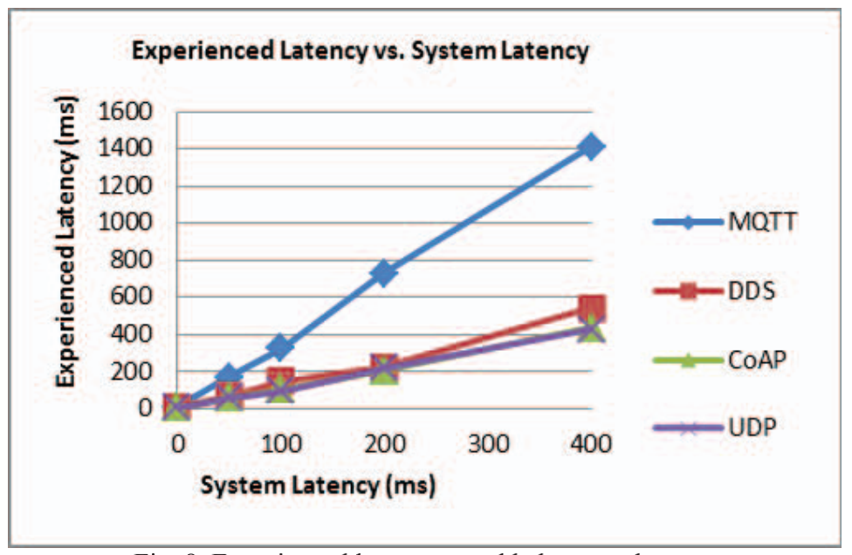
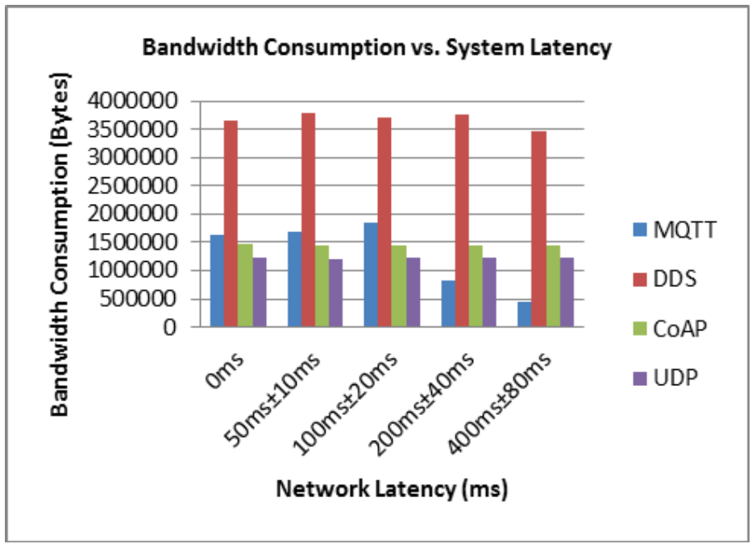
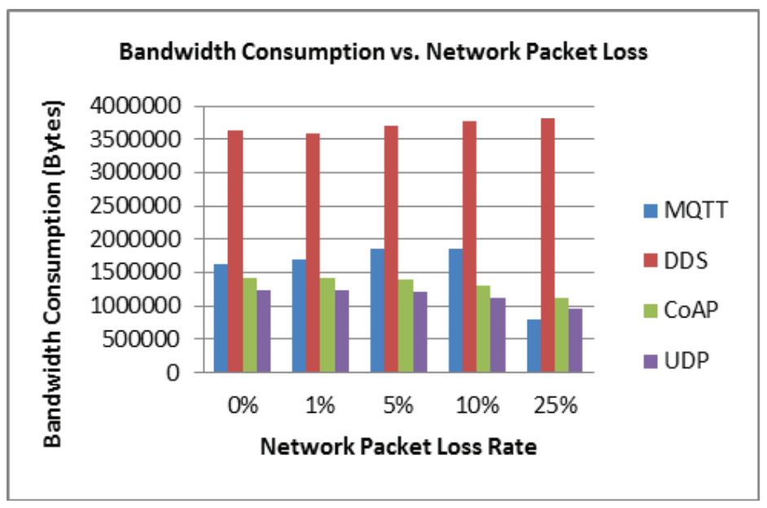
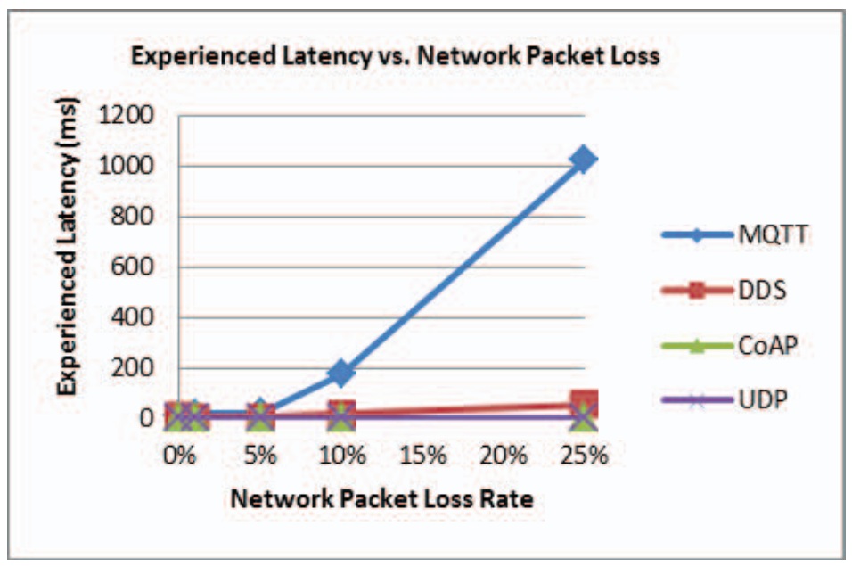
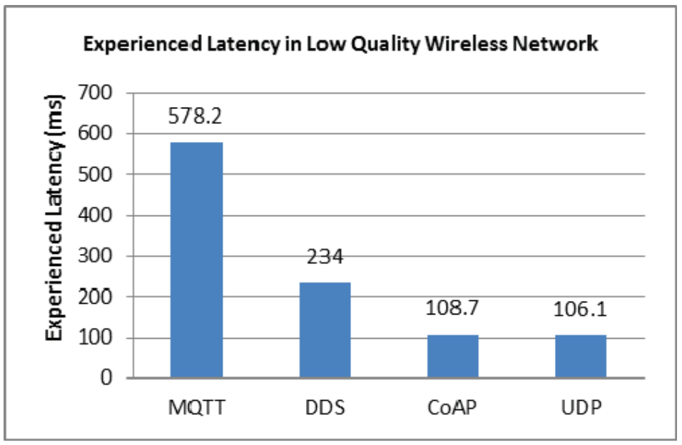
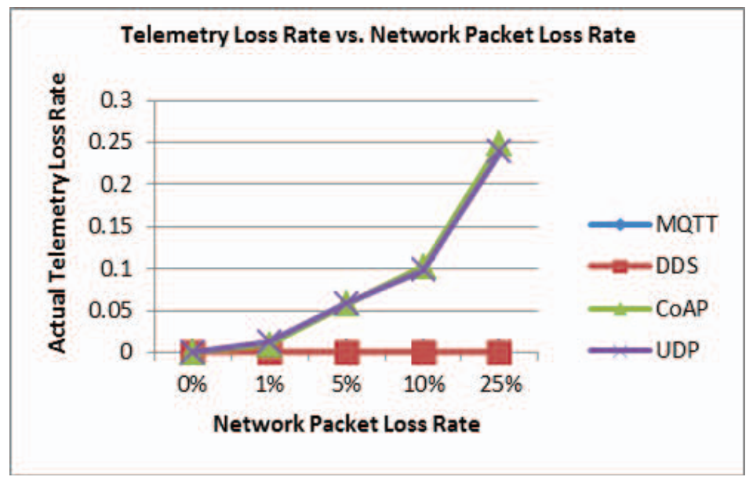
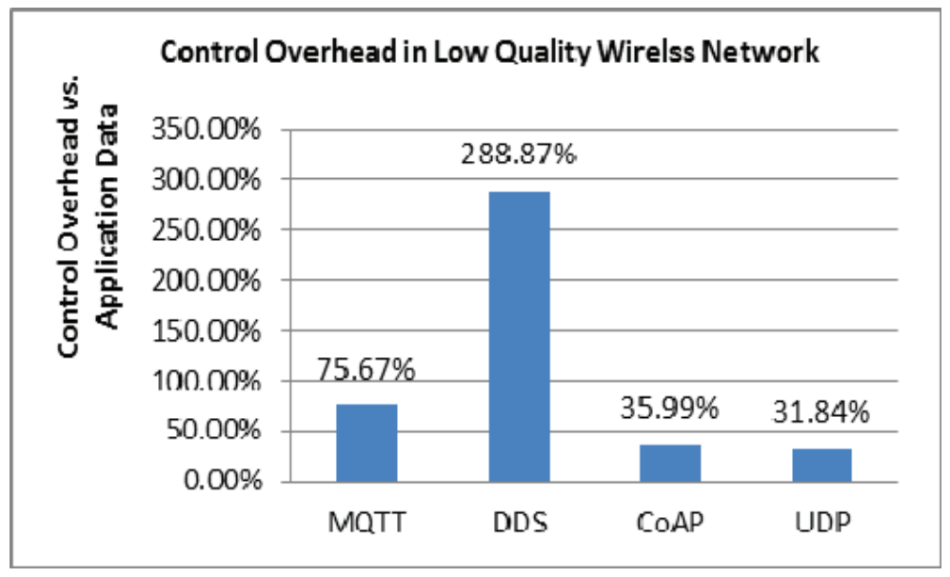
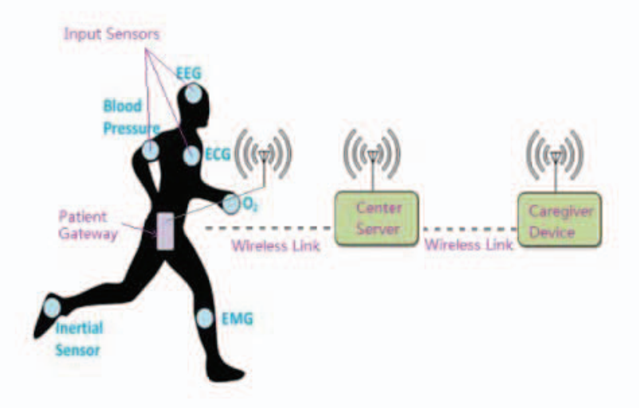
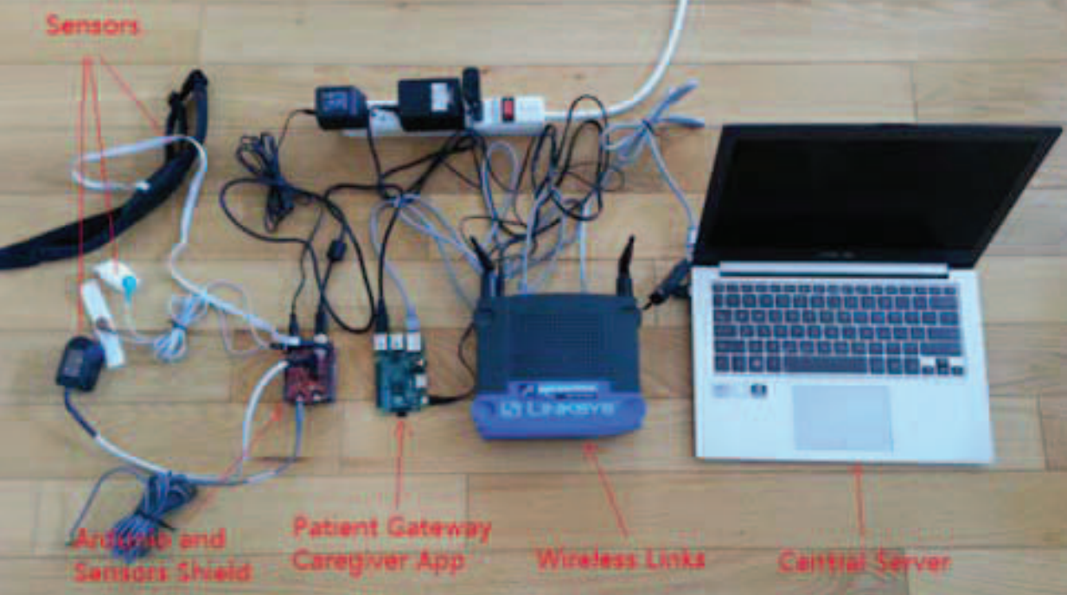
Review: Performance Evaluation of IoT Protocols under a Constrained Wireless Access Network
Hardware Setup
• Raspberry Pi
• eHealth Sensor Kit
• Arduino Uno Central Server
• Windows Laptop
• Linksys Network Router
Software Setup
• To simulate a constrained low reliability network, NetEM (an enhancement of the Linux traffic control facilities) is used to set packet loss and latency of outgoing packets; TBF (Token Bucket Filter, is used to control network bandwidth) is used to set bandwidth on both server and client.
• All trials for each independent variable setting are set to run for 10 minutes and 3 repetitions with the final reported result being the average of the three trials.
• In all tests, 981,600 bytes of application data was transmitted by the patient application in a 10 minute interval.
ECE 498 ICC, SP 2020, ZJU-UIUC Institute © 2019-2020 Yucheng Jin & Heyuan Li. All rights reserved. Slide

Slide 5
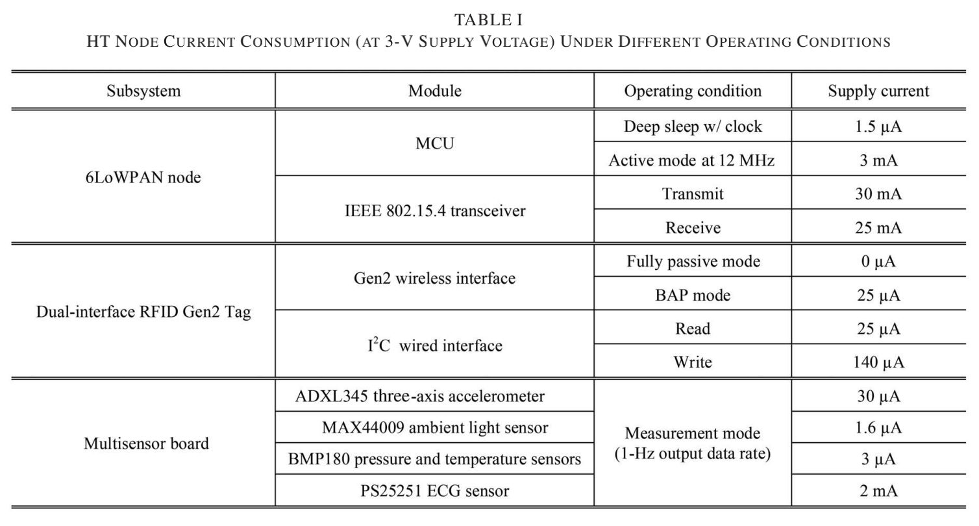
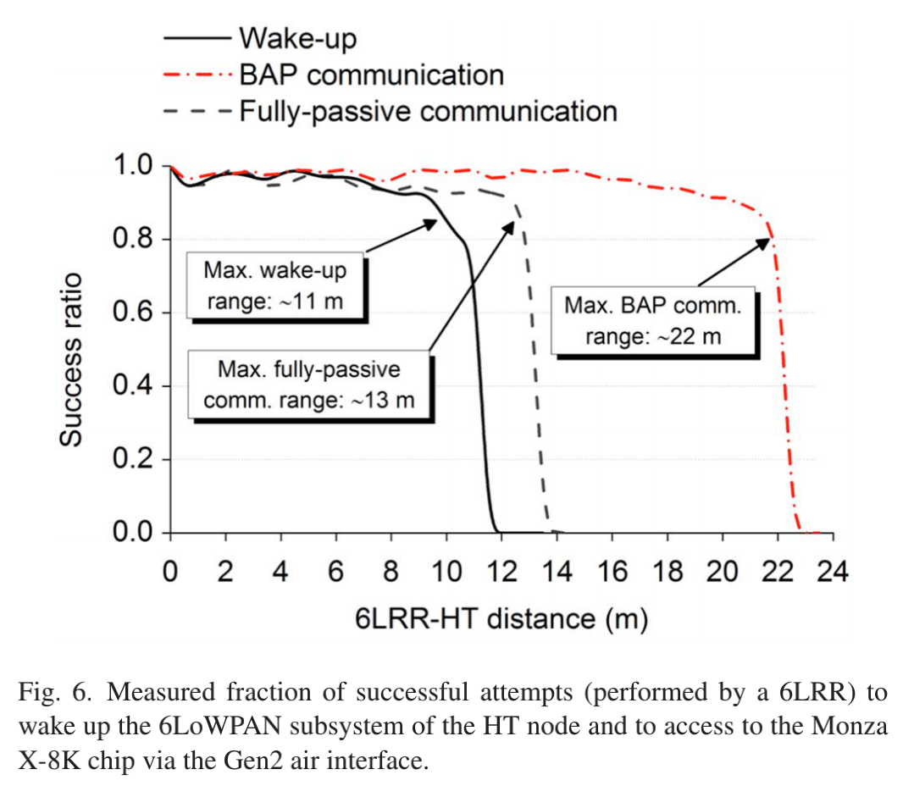
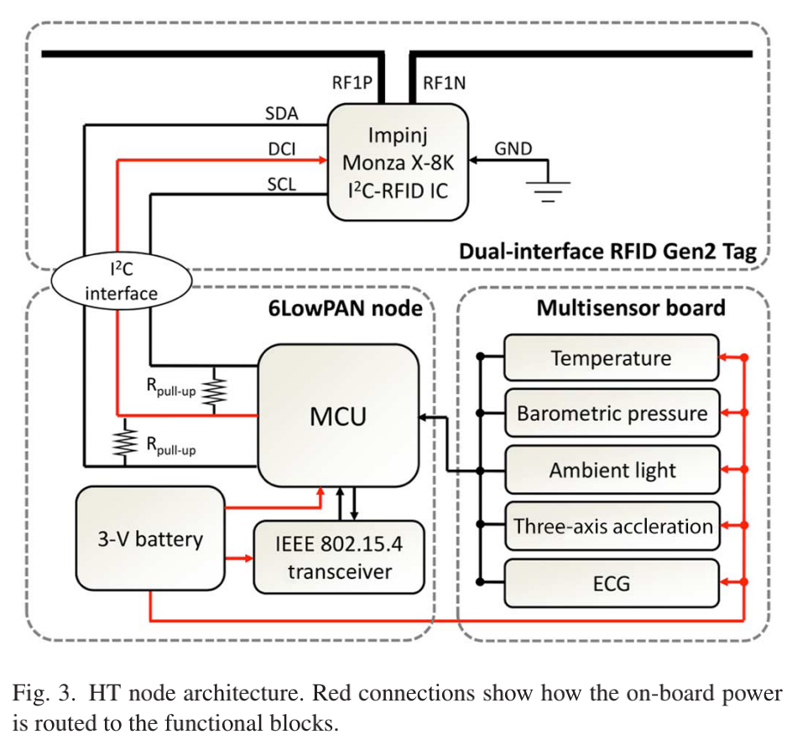
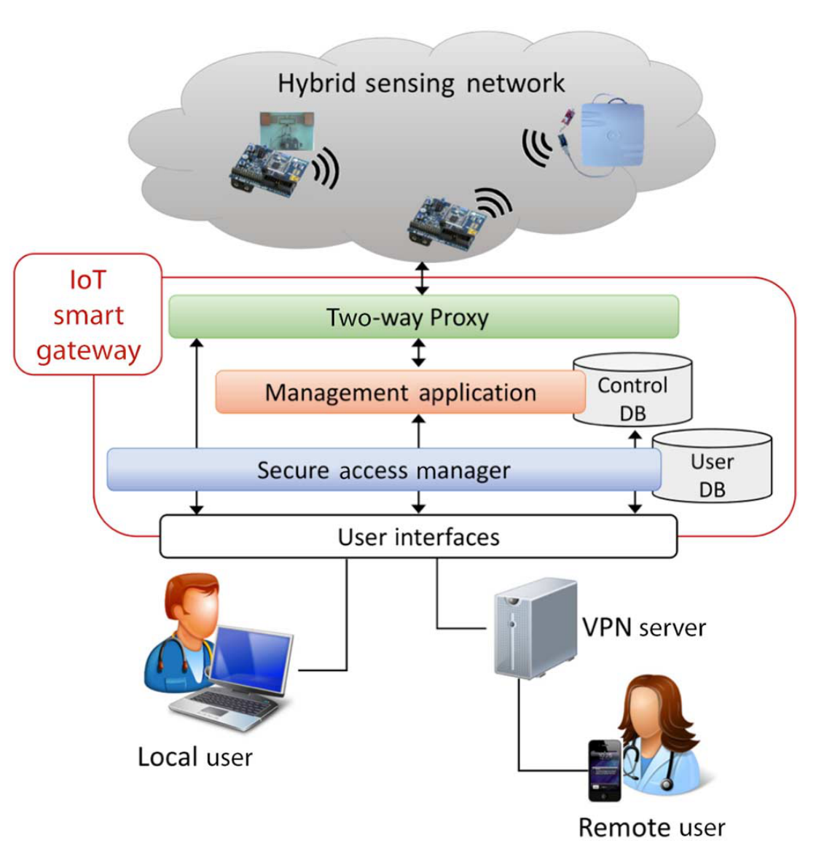
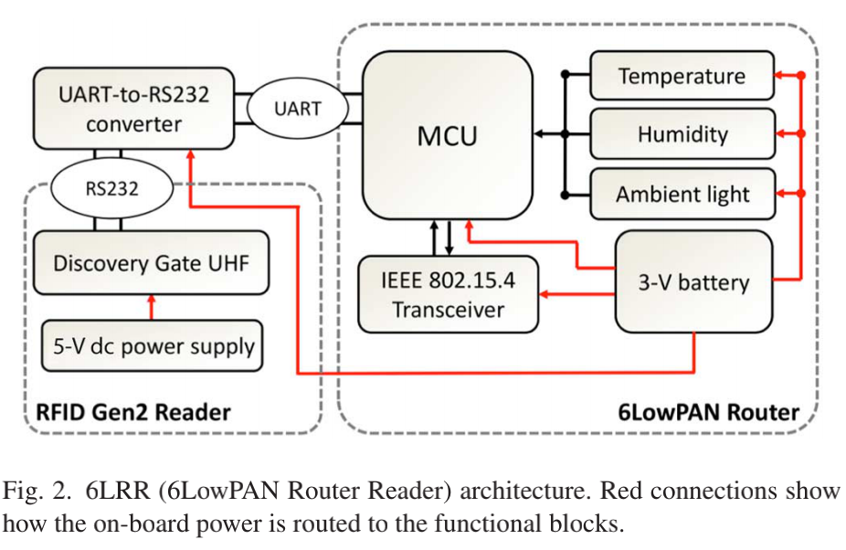
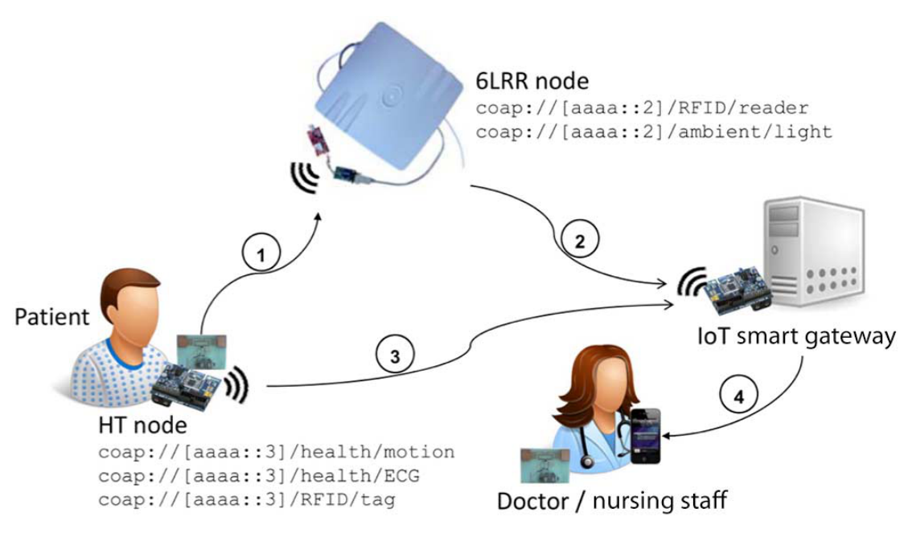
Review: An IoT-Aware Architecture for Smart
Healthcare Systems
This paper proposes a novel, IoT-aware, smart architecture, smart hospital system (SHS), for automatic monitoring and tracking of patients, personnel, and biomedical devices within hospitals and nursing institutes.
The smart hospital system (SHS) is consisted of following components:
Ultra-high-frequency (UHF) radio frequency identification (RFID), wireless sensor network (WSN), and smart mobile represent three of the most promising technologies enabling the implementation of the smart healthcare system (SHS). Besides, the system also integrates 6LoWPAN and Constrained Application Protocol (CoAP).
RFID uses electromagnetic fields to automatically identify and track tags attached to objects.
WSN is a network of nodes that work cooperatively to sense and control the surrounding environment.
6LoWPAN is a form of WSN that sends data as packets and using IPv6 protocol.
Overview of the SHS Architecture
SHS Validation Scenario
Table I summarizes the current consumption of different modules and peripherals of the HT node at 3-V supply voltage
ECE 498 ICC, SP 2020, ZJU-UIUC Institute © 2019-2020 Yucheng Jin & Heyuan Li. All rights reserved. Slide

Slide 6
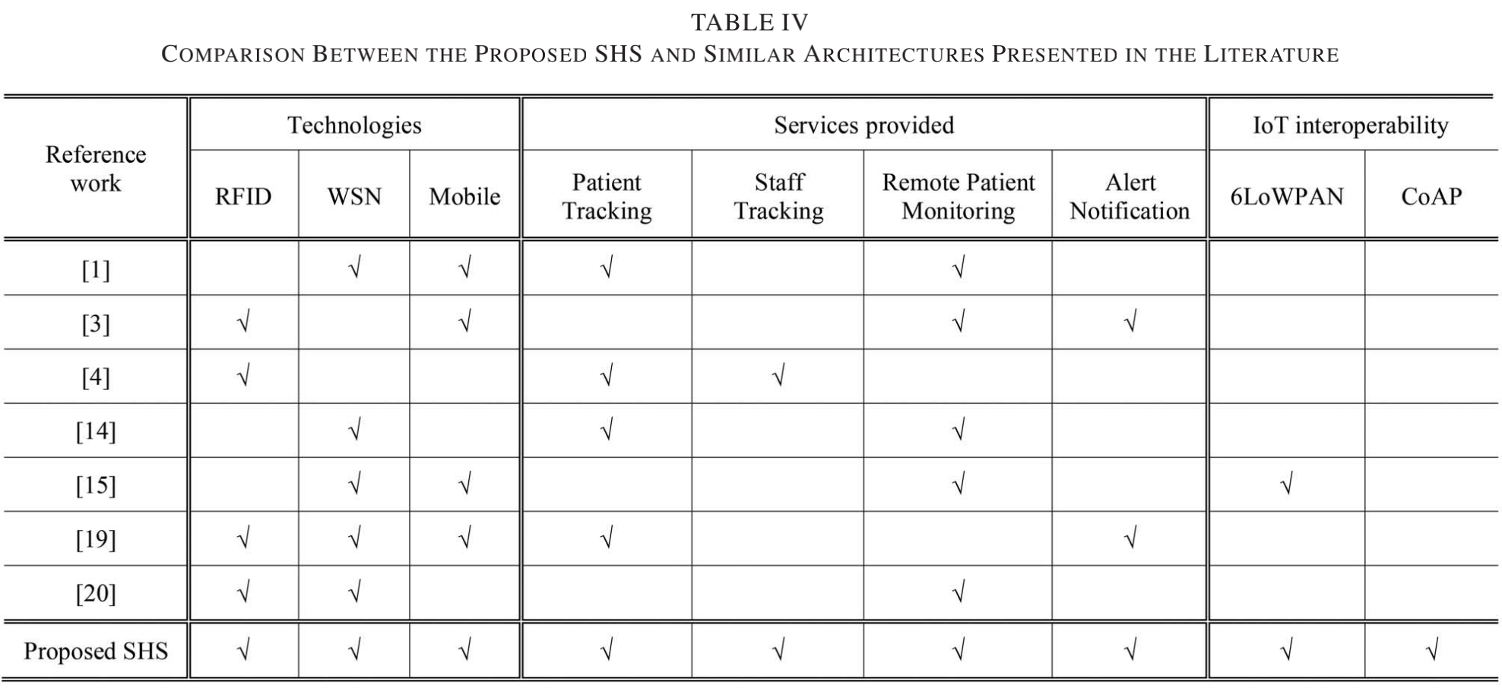
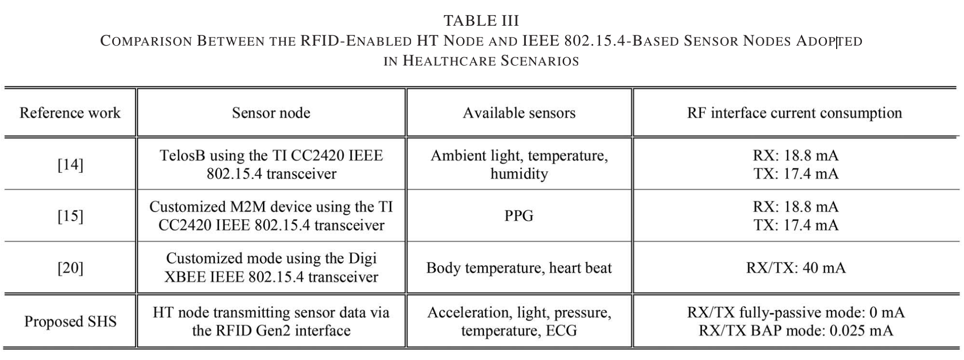
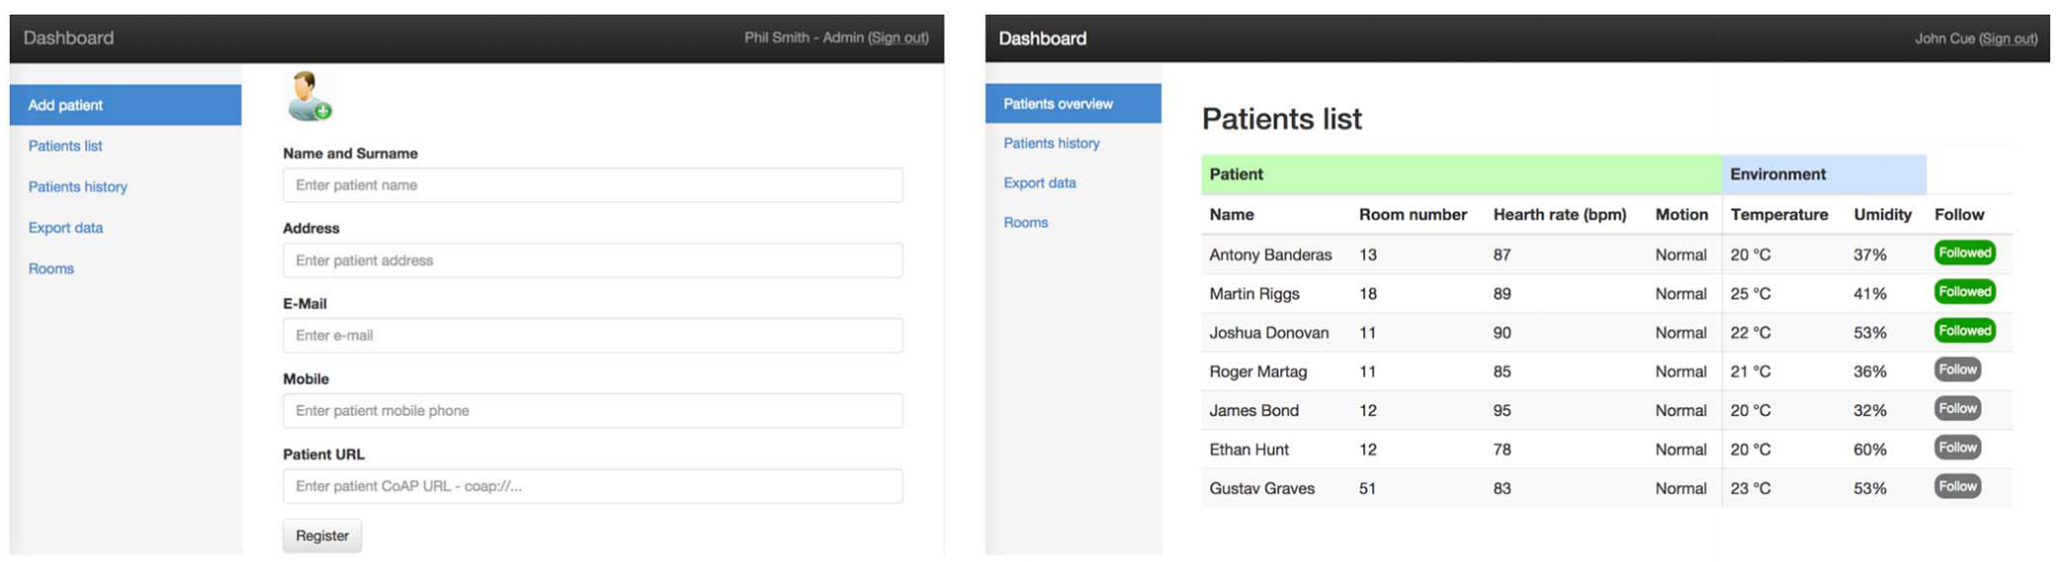
Review: An IoT-Aware Architecture for Smart
Healthcare Systems
Architecture details:
Hybrid Sensing Network consists of an integrated RFID-WSN 6LoWPAN network.
IoT Smart Gateway represents the core of the proposed SHS. It is in charge of data collection and processing, system management, and service execution. Hence, it controls the overall SHS behavior.
User Interfaces
ECE 498 ICC, SP 2020, ZJU-UIUC Institute © 2019-2020 Yucheng Jin & Heyuan Li. All rights reserved. Slide

Slide 7
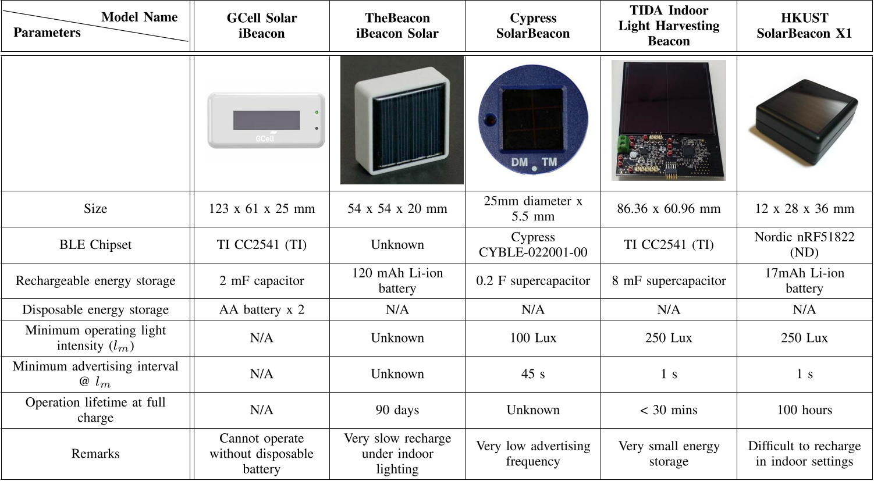
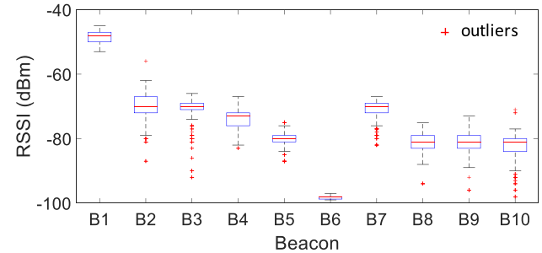
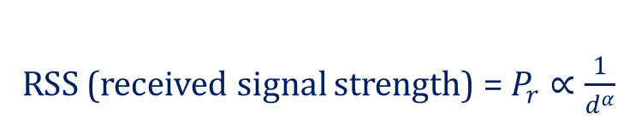
Review: BLE Beacons for Internet of Things Applications Survey, Challenges, and Opportunities
Three BLE beacon IoT applications
1. Indoor localization
2. Proximity detection
3. Activity sensing
Two BLE protocols and the signal characteristics
RSS (received signal strength) = $P_{r}∝\frac{1}{d^{α}}$
BLE beacon hardware choices
1. iBeacon by Apple
2. Eddystone by Google
How the software and system for BLE beacons account for practical issues
Existing challenges for BLE beacon applications
1. Battery monitoring
2. Distance estimation
3. Security issues
4. System scalability
1. Incompatible protocols
2. Insufficient hardware technologies
Plot of BLE beacon RSS in a dense environment
ECE 498 ICC, SP 2020, ZJU-UIUC Institute © 2019-2020 Yucheng Jin & Heyuan Li. All rights reserved. Slide

Slide 8
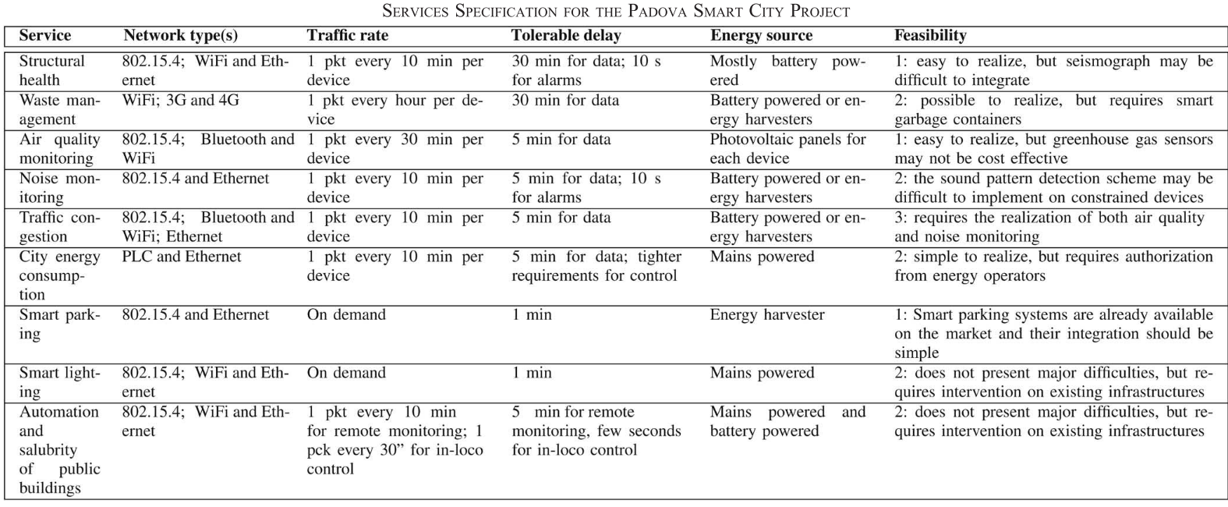
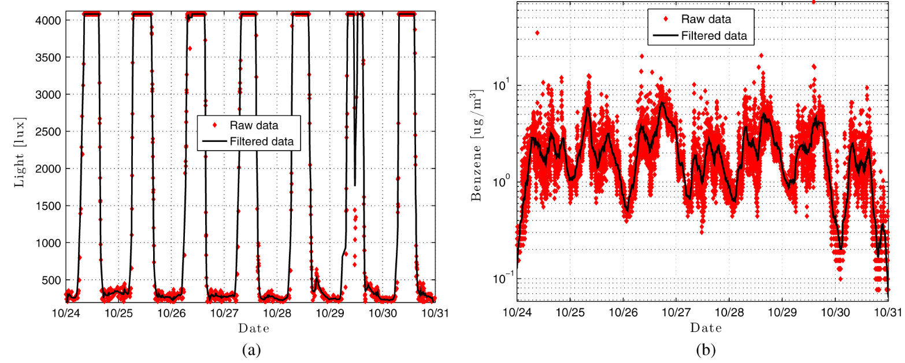
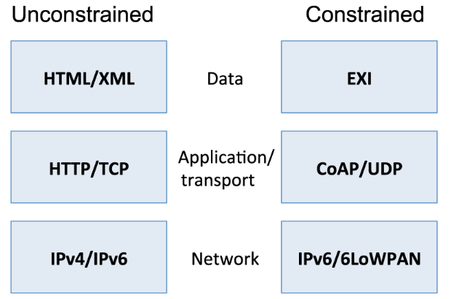
Review: Internet of Things for Smart Cities
Difficulties in building a Smart City and its services
Architecture of a Smart City
1. web service
2. link layers
3. devices
Case study of the "Padova Smart City" project
Example data collected in the Padova Smart City
Interfacing between the Internet and IoT devices
ECE 498 ICC, SP 2020, ZJU-UIUC Institute © 2019-2020 Yucheng Jin & Heyuan Li. All rights reserved. Slide

Slide 9
Relationship of the Four Papers
Commonalities
The importance of choosing an appropriate protocol is emphasized
The papers are all application oriented (they are all aimed for deployment to specific application scenarios)
Uniqueness
The IoT protocol evaluation paper mainly focuses on measuring the performance of four different protocols under extreme conditions
The Smart City paper and the Smart Healthcare System paper discuss the realization of some applicable IoT system
ECE 498 ICC, SP 2020, ZJU-UIUC Institute © 2019-2020 Yucheng Jin & Heyuan Li. All rights reserved. Slide

Slide 10
Weakness & Unsolved Problems
Protocol Evaluation Paper
More comparisons of basic performance metrics can be performed
More protocols can be included, such as AMQP and JMS
Smart Hospital System Paper
Cloud computing can be integrated into the system to handle larger amount of patients’ data
A security system can be designed to improve the protection of patients’ privacy
ECE 498 ICC, SP 2020, ZJU-UIUC Institute © 2019-2020 Yucheng Jin & Heyuan Li. All rights reserved. Slide

Slide 11
Weakness & Unsolved Problems
BLE Beacon Paper
Future research opportunities are less convincing based on qualitative evaluation
No novel ideas supported by quantitative experiments
Smart City Paper
Lacks discussion on how to integrate each component of the Smart City
The Padova Smart City project example lacks insights on exploiting the data collected
ECE 498 ICC, SP 2020, ZJU-UIUC Institute © 2019-2020 Yucheng Jin & Heyuan Li. All rights reserved. Slide

Slide 12
What We’ve Learned from the Papers
Protocol Evaluation Paper
This paper successfully implements a variable-controlling approach to design experiments to evaluate the performance of different protocols using three quantitative metrics: bandwidth consumption, experienced latency, and experienced packet loss.
Smart Hospital System Paper
The paper proposes a Smart Hospital System consisted of RFID, WSN, and smart mobile for automatic monitoring and tracking of patients, which could be a promising solution to improve the life quality in hospitals and nursing homes.
ECE 498 ICC, SP 2020, ZJU-UIUC Institute © 2019-2020 Yucheng Jin & Heyuan Li. All rights reserved. Slide

Slide 13
What We’ve Learned from the Papers
BLE Beacon Paper
Although the study of BLE beacon technology is still in its infancy, future study on this technology is promising because of its inexpensive hardware, insignificant form factor, and the protocol flexibility that enables the hosting of various types of applications.
Smart City Paper
The great potential for a Smart City model to improve the living standards of citizens and the operation of local government is supported by a wide range of services, including smart parking, building monitoring, environmental monitoring, and traffic congestion management.
ECE 498 ICC, SP 2020, ZJU-UIUC Institute © 2019-2020 Yucheng Jin & Heyuan Li. All rights reserved. Slide

Slide 14
Q & A
Q & A
ECE 498 ICC, SP 2020, ZJU-UIUC Institute © 2019-2020 Yucheng Jin & Heyuan Li. All rights reserved. Slide

Slide 15
Thank You for Listening
Thank You for Listening
ECE 498 ICC, SP 2020, ZJU-UIUC Institute © 2019-2020 Yucheng Jin & Heyuan Li. All rights reserved. Slide

